Slide 1
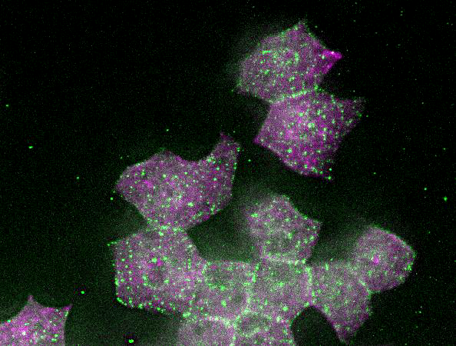
Sparklers and Explosions:
life in the cortex moves to the nucleus at prophase
GREEN – rfp-WTIP
Magenta – gfp-Rab11

