Slide 1
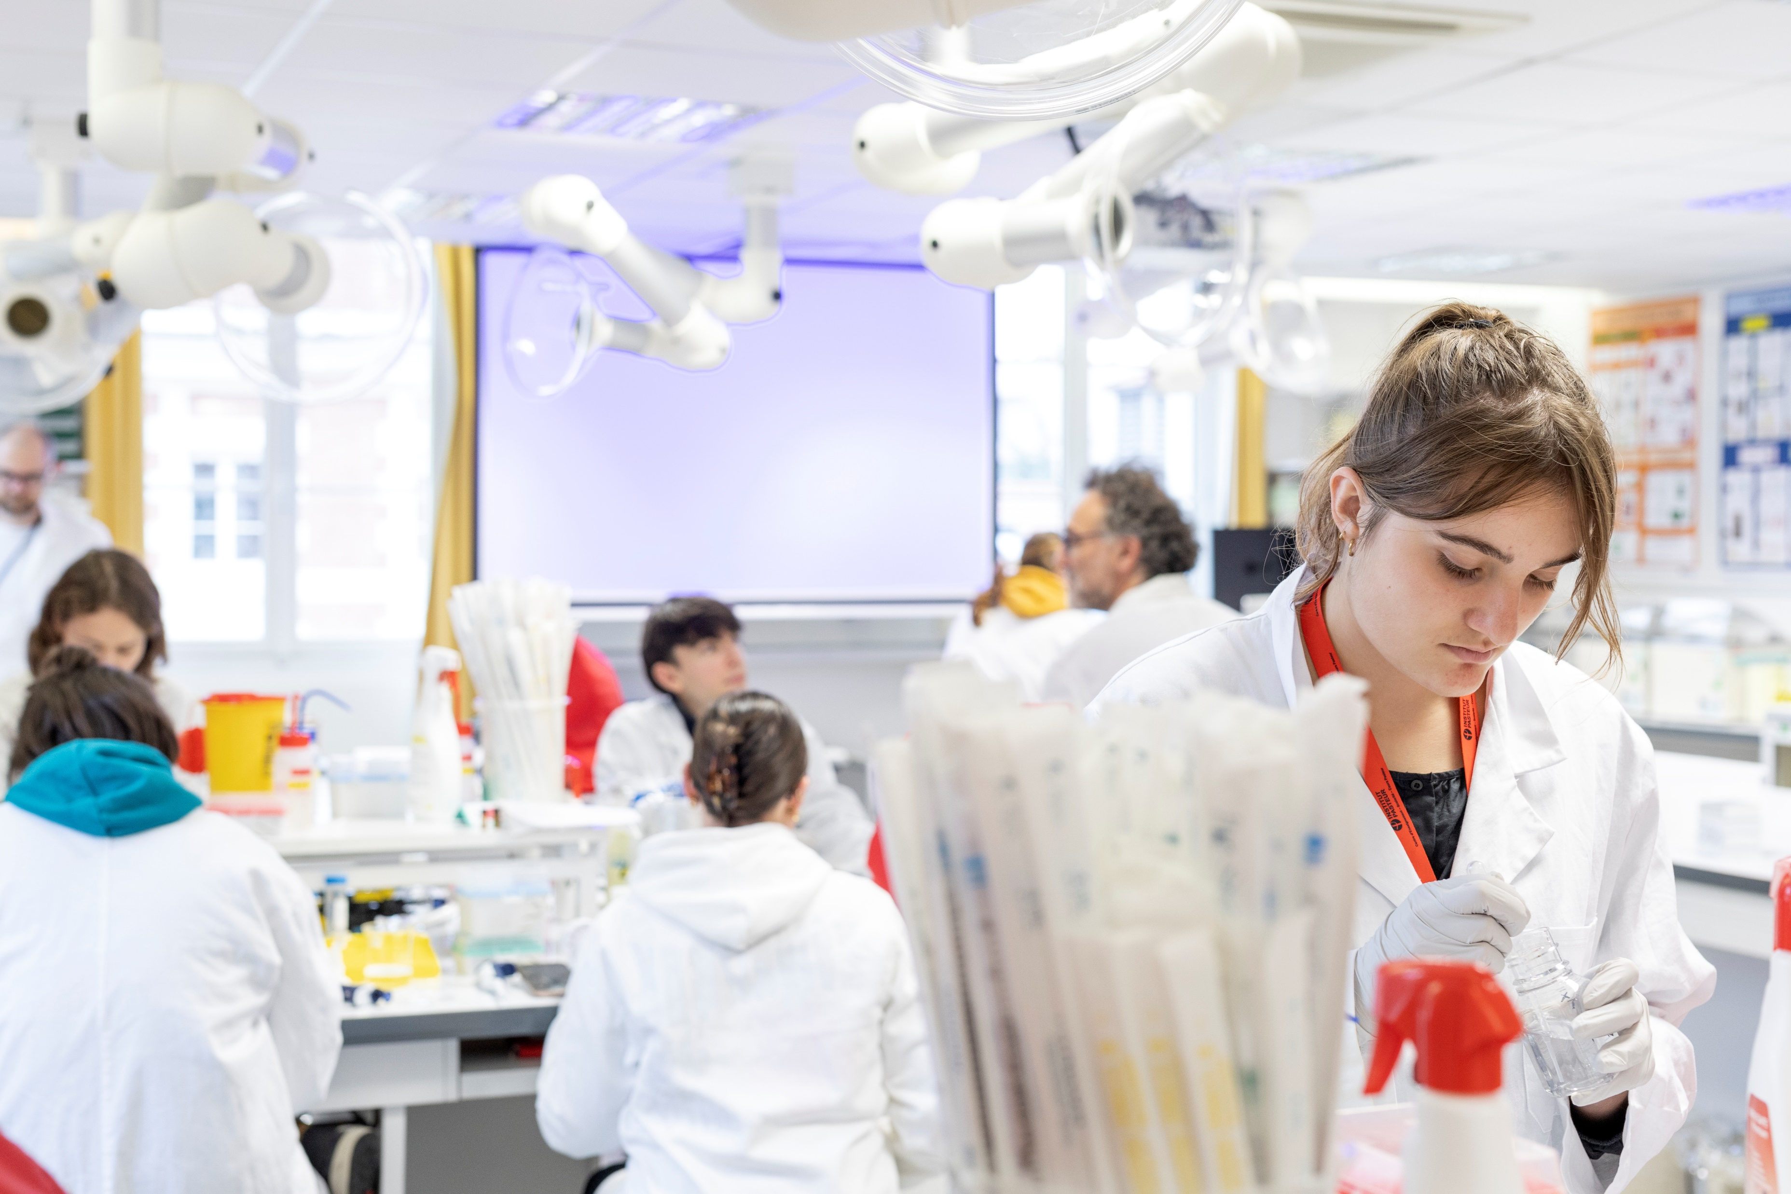
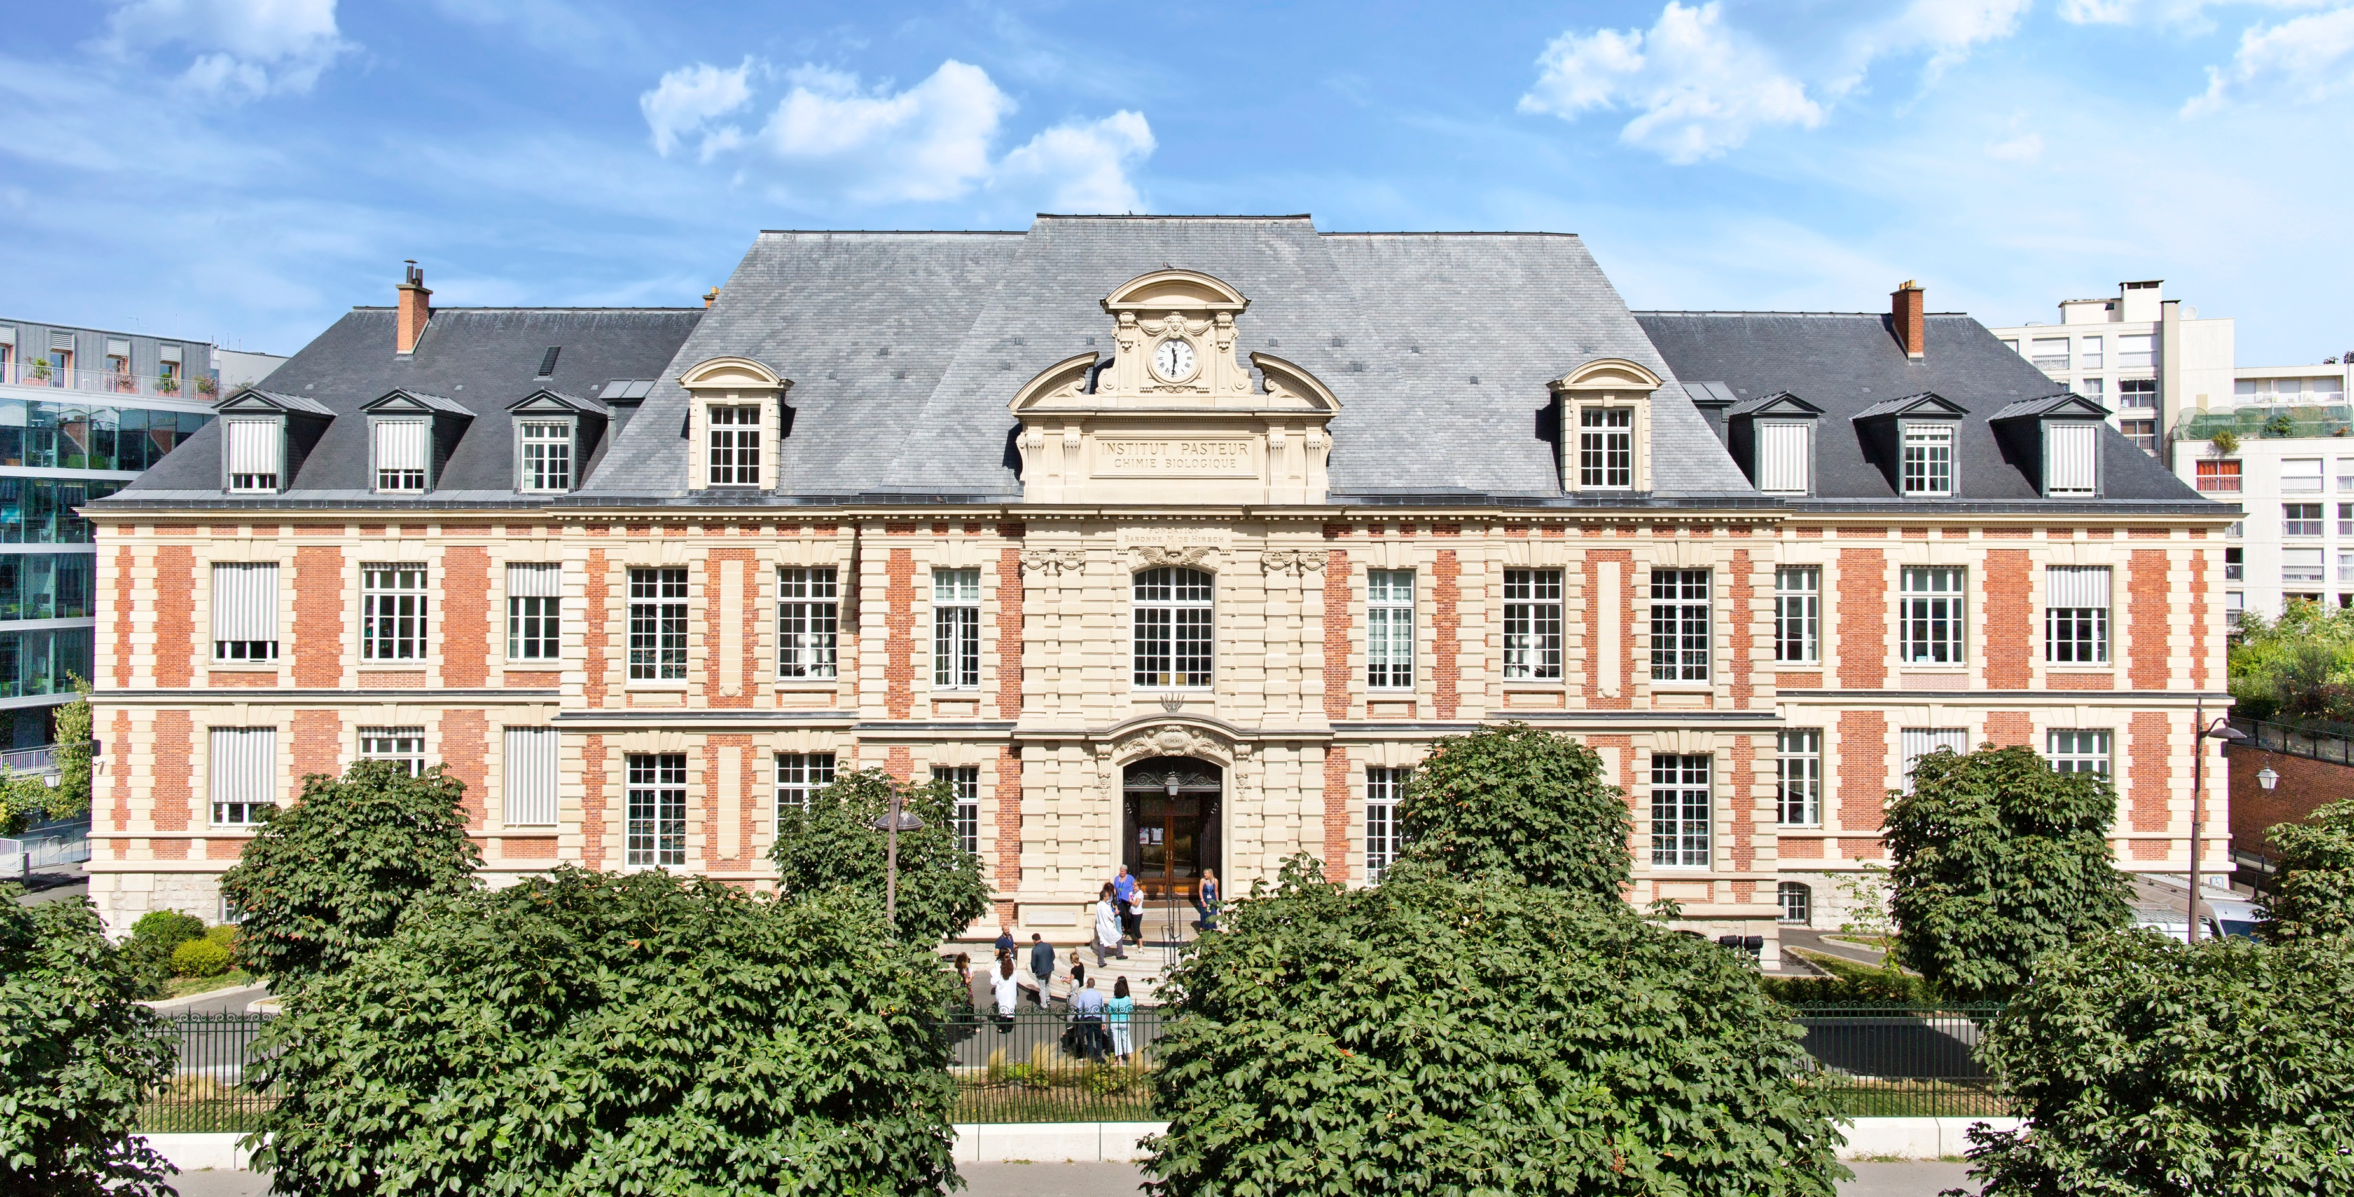
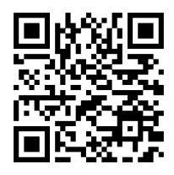
Call for applications 2024
Creation of new research groups at the Institut Pasteur
Research focus
The Institut Pasteur is interested in transdisciplinary approaches to tackle important health threats, such as:
Vaccinology & immunotherapies
Infectious diseases, with a focus on anti-microbial resistance, medicinal chemistry and chemical biology
Neuro-immunology and neurodevelopment
Maternal and child health (immunology, infection, pregnancy, development)
Attractive starting package
Includes a PI permanent position, a technician position, postdoc fellowship as well as recurrent funding & equipment budget
Join a scientific community at the service of excellence
140+ research units
30+ technological core facilities
An education center
Deadline for applications:
February 28, 2025

